Slide 1
Forecasting Electricity Prices: A Data- Driven Approach for Enhanced Decision- making

Slide 2
WELCOME

Slide 3

Introduction
Forecasting Electricity Prices: A Data- Driven Approach for Enhanced Decision- making

Slide 4

Objective
Understand the importance of accurate electricity price forecasting and its impact on decision-making in the energy sector. Explore how a data-driven approach can enhance forecasting accuracy and provide valuable insights for businesses.

Slide 5

Challenges in Electricity Price Forecasting
Discuss the complexity of electricity price dynamics and the challenges faced in accurately predicting price ﬂuctuations. Highlight the impact of market factors, weather conditions, and regulatory changes on electricity prices.

Slide 6

Data Collection and Analysis
Outline the data collection process for electricity price forecasting, including sources such as historical price data, weather data, and market indicators.
Explain the importance of data preprocessing and feature engineering for accurate analysis.

Slide 7

Forecasting Models
Explore different forecasting models commonly used in electricity price forecasting, such as time series analysis, machine learning, and ensemble methods. Discuss the pros and cons of each approach.

Slide 8
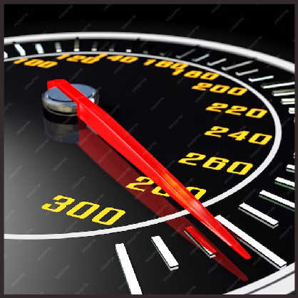
Evaluation Metrics
Introduce evaluation metrics used to assess the performance of electricity price forecasting models, including mean absolute error (MAE), root mean square error (RMSE), and mean absolute percentage error (MAPE).

Slide 9

Case Studies
Present real-world case studies showcasing successful applications of data-driven electricity price forecasting. Highlight the beneﬁts achieved, such as cost savings, improved decision-making, and optimized resource allocation.

Slide 10

Conclusion
Summarize the key points discussed, emphasizing the importance of data- driven approaches for accurate electricity price forecasting. Highlight the potential beneﬁts of enhanced decision-making and improved resource management in the energy sector.

Slide 11
Thanks!

